Slide 1
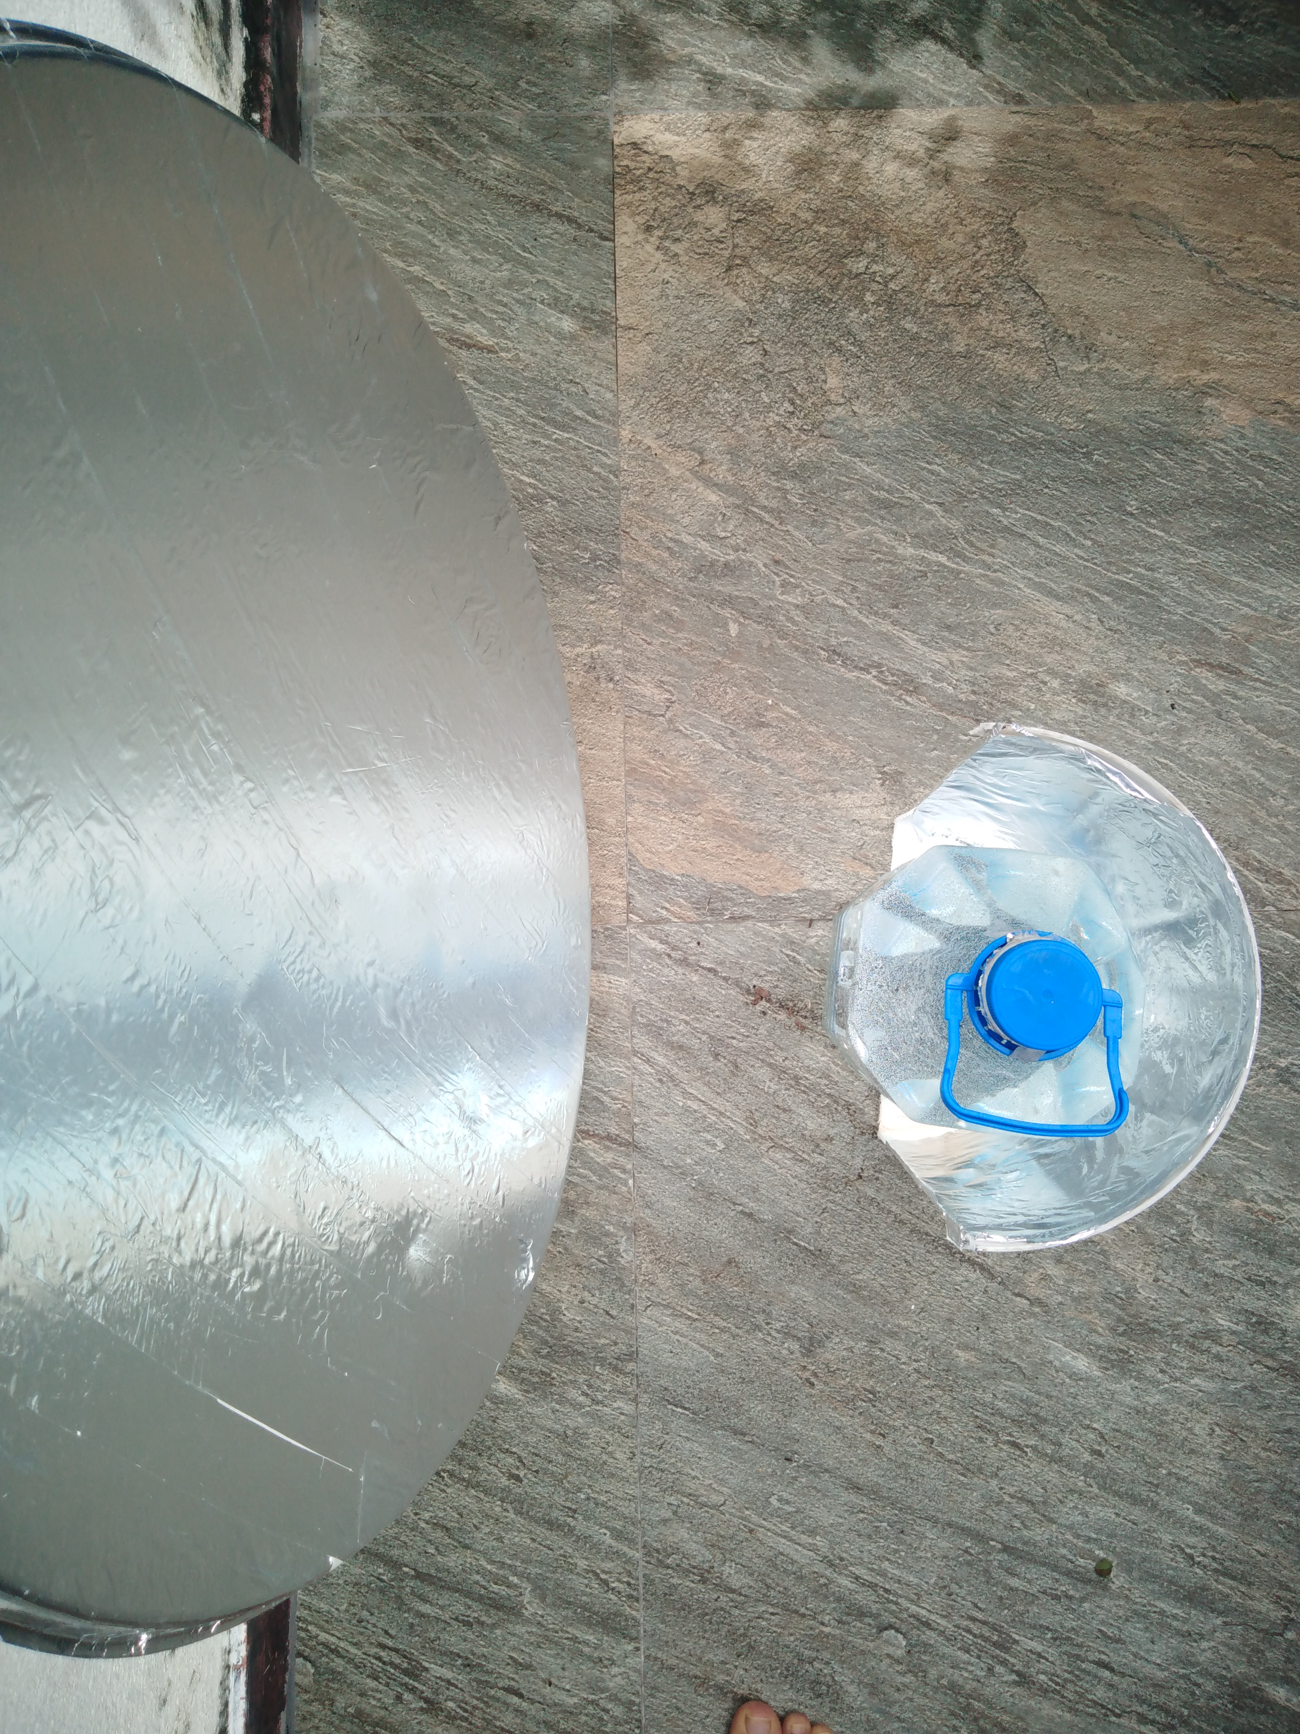
CSP Water Heater
Gamika Seneviratne

Slide 2
Abstract
Aim: Introduce the concept of a cheap, DIY design for a solar water heater
Application: For rural areas, low-capita income, with cold whether
Requirements: Reused satellite dish, foil/wrapping paper, bottle, PVC/metal pipe

Slide 3
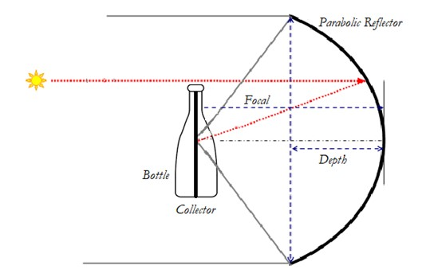
Principle
Parabolic dish acts as concentrator
Bottle is heated from the inside – 100% of energy directly transferred to surrounding water from receiver
Heat losses only from water to surface of bottle, limited by covering bottle with wrapping paper
Source: Rebuilt from various sources

Slide 4
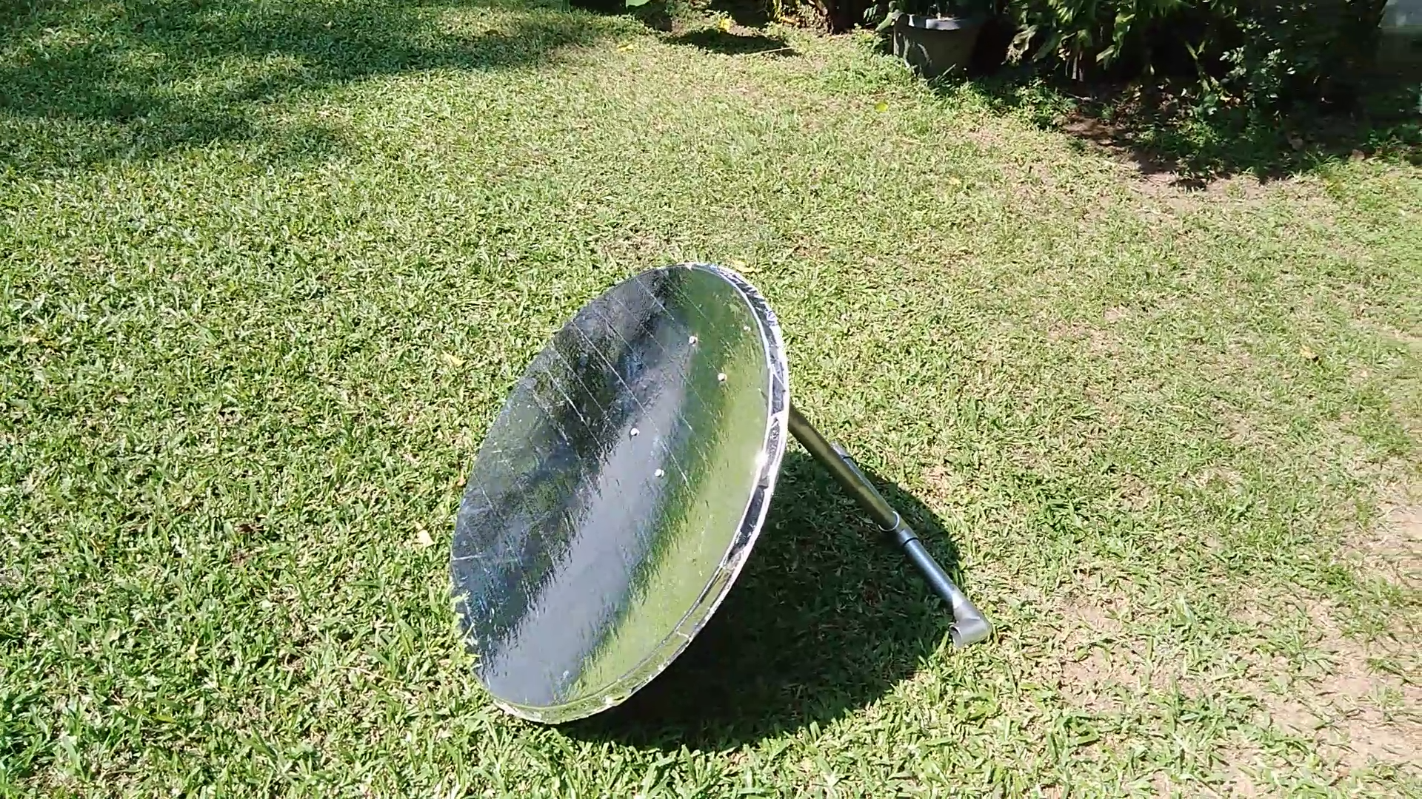
Design
CSP is an established technology so why is this different?
- Reuses old/cheap products
Concentrator – a reused satellite TV dish which acts as an efficient parabolic concentrator
Water storage - Fully transparent plastic or glass bottle
Receiver - PVC pipe, best coated with non-reflective paint
Video: https://www.youtube.com/watch?v=eoZ5gvtdADc

Slide 5
Testing and Results
This CSP setup was capable of heating a 5L bottle (PET plastic) to 70C in (ambient 25C ) in ~2 hours
Or ~0.4KWh of energy saved
Results achieved under constant sunshine with no cloud cover (over winter; Nov – Jan)
System is much cheaper than current Solar Thermals and far more efficient at heating applications vs. PVs
Issues to note:
The device has to be adjusted every ~45mins to align the focal point to the receiver to track the sun’s motion
Care must be taken to avoid aligning focal point in direction of person or flammable objects (e.g. youtube.com) . Sunglasses are highly recommended

Slide 6
Design - Improvements
Tracking is often a problem with CSP devices
Therefore the next iterations would explore finding cheap ways to design Compound Parabolic Collectors that automatically track the suns movement
These do not require actuators to track the sun – at least across a range of incident angles
Industrial Uses:
Large scale heating applications (water or otherwise)
Water disinfection and even desalination
High power application can be used to drive steam turbines
(a) Parabolic trough collector (b) a compound parabolic collector
Source: Solar photocatalysis for water disinfection

